Slide 1
Chapter 13
How to work with forms

Slide 2
Objectives
Applied
Use HTML to create a form that includes any of the form controls.
Use CSS to format a form and its controls.
Use the HTML attributes and CSS selectors for validating the data that gets entered into a form.
Use an HTML form to add a search function to a website.

Slide 3
Objectives (continued)
Knowledge
Describe the use of an HTML form for initiating client-side processing or submitting data to a web server.
Describe the get and post methods that can be used to submit a form.
Describe the use of any of the form controls.
Describe the use of tab order and access keys.
Describe the use of these HTML attributes: autocomplete, required, and pattern.
Describe the use of regular expressions.
Describe the use of a form that provides a search function for a website.
Describe the use of a data list control.

Slide 4
Attributes of the form element
id
action
method
Attributes common to most input elements
type
id
name
disabled
readonly

Slide 5
The HTML for a form
<form id="email_form" action="subscribe.php"
method="post">
<p>Please enter your e-mail address to subscribe to
our newsletter.</p>
<p>E-Mail: <input type="text" id="email"></p>
<p><input type="submit" id="submit"
value="Subscribe"></p>
</form>

Slide 6
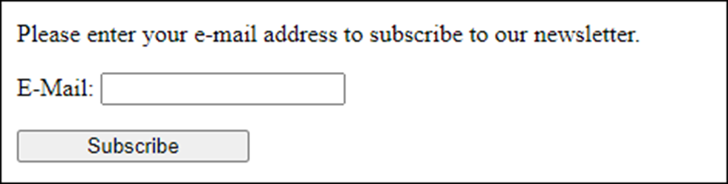
The form in a web browser
The URL when the form is submitted with the get method
subscribe.php?email=zak%40modulemedia.com&submit=Subscribe

Slide 7
Attributes of the input element for buttons and for the button element
type
value
src
alt
height
width

Slide 8
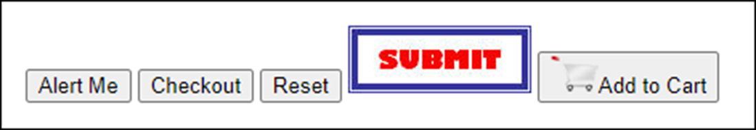
Four buttons that are created by the input element
<input type="button" id="message" value="Alert Me">
<input type="submit" id="checkout" value="Checkout">
<input type="reset" id="resetform" value="Reset">
<input type="image" src="images/submit.jpg"
alt="Submit button" width="114" height="42">
A button that is created by the button element
<button type="submit">
<img src="images/addtocart.png" width="30"
height="23" alt="Add to Cart">Add to Cart
</button>
The buttons in a web browser

Slide 9
Attributes of the input element for text fields
type
value
maxlength
autofocus
placeholder

Slide 10
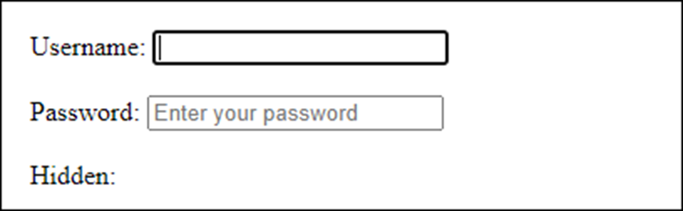
The HTML for text fields
Username:<input type="text" id="username"
autofocus><br><br>
Password:<input type="password"
id="password"
maxlength="6"
placeholder="Enter your password">
<br><br>
Hidden:<input type="hidden" id="productid"
value="widget">
The text fields in a web browser

Slide 11
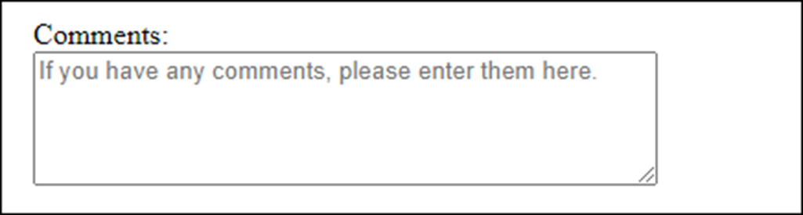
The HTML for a text area with default text
Comments:<br>
<textarea id="comments"
placeholder="If you have any comments,
please enter them here.">
</textarea>
The CSS for the text area
textarea { height: 5em; width: 25em; }
The text area in a web browser

Slide 12
The HTML for a form with label elements
Crust:<br>
<input type="radio" name="crust" id="crust1" value="thin"
checked>
<label for="crust1">Thin Crust</label><br>
<input type="radio" name="crust" id="crust2"
value="deep">
<label for="crust2">Deep Dish</label><br>
<input type="radio" name="crust" id="crust3"
value="hand">
<label for="crust3">Hand Tossed</label><br><br>
Toppings:<br>
<input type="checkbox" name="topping1" id="topping1"
value="pepperoni">
<label for="topping1">Pepperoni</label><br>
<input type="checkbox" name="topping2" id="topping2"
value="mushrooms">
<label for="topping2">Mushrooms</label><br>
<input type="checkbox" name="topping3" id="topping3"
value="Black Olives">
<label for="topping3">Black Olives</label><br><br>

Slide 13
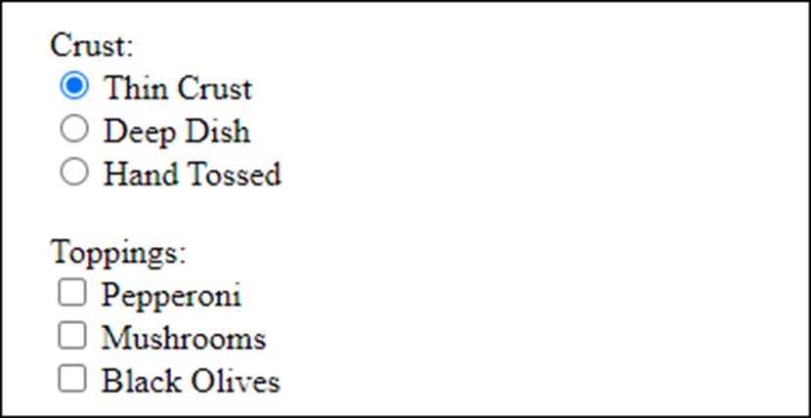
The radio buttons and check boxes in a web browser

Slide 14
Accessibility guideline for labels with radio buttons and check boxes
Use labels with radio buttons and check boxes so the user can click on the label to select the control that the label is associated with.
This also helps assistive devices.

Slide 15
The HTML for a drop-down list
Style:<br>
<select id="style_and_size">
<optgroup label="The New Yorker">
<option value="ny10">10"</option>
<option value="ny12">12"</option>
<option value="ny16">16"</option>
</optgroup>
<optgroup label="The Chicago">
<option value="chi10">10"</option>
<option value="chi12">12"</option>
<option value="chi16">16"</option>
</optgroup>
</select>

Slide 16
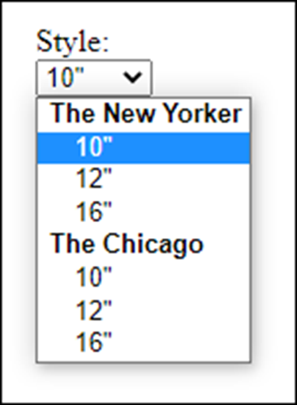
The drop-down list in a web browser when the user clicks on the arrow

Slide 17
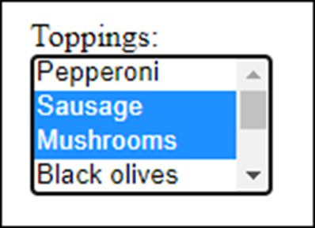
The HTML for a list box
<select id="toppings" size="4" multiple>
<option value="pepperoni">Pepperoni</option>
<option value="sausage" selected>Sausage</option>
<option value="mushrooms">Mushrooms</option>
<option value="olives">Black olives</option>
...
</select>
The list box in a web browser with a scroll bar

Slide 18
HTML code that uses the number, email, url, and tel controls
<form id="email_form" action="survey.php" method="post">
<label for="investment">Monthly investment: </label>
<input type="number" id="investment"
min="100" max="1000" step="100"
value="300"><br><br>
<label for="email">Your email address:</label>
<input type="email" id="email" required><br>
<label for="link">Your website:</label>
<input type="url" id="link" list="links"><br>
<label for="phone">Your phone number:</label>
<input type="tel" id="phone" required><br><br>
<input type="submit" id="submit"
value="Submit Survey">
</form>

Slide 19
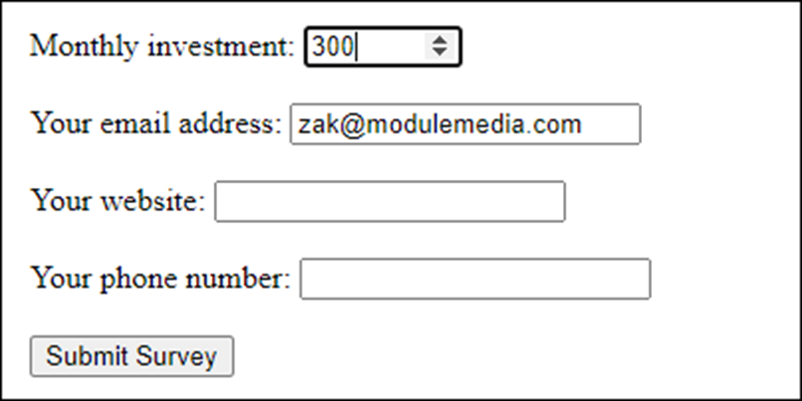
The form in Chrome

Slide 20
HTML that uses the date and time controls
Date and time:&nbsp;&nbsp;
<input type="datetime" name="datetime"><br><br>
Local date and time:&nbsp;&nbsp;
<input type="datetime-local"
id="datetimelocal"><br><br>
Month:&nbsp;&nbsp;
<input type="month" id="month"><br><br>
Week:&nbsp;&nbsp;
<input type="week" id="week"><br><br>
Time:&nbsp;&nbsp;
<input type="time" id="time"><br><br>
Date:&nbsp;&nbsp;
<input type="date" id="date">

Slide 21
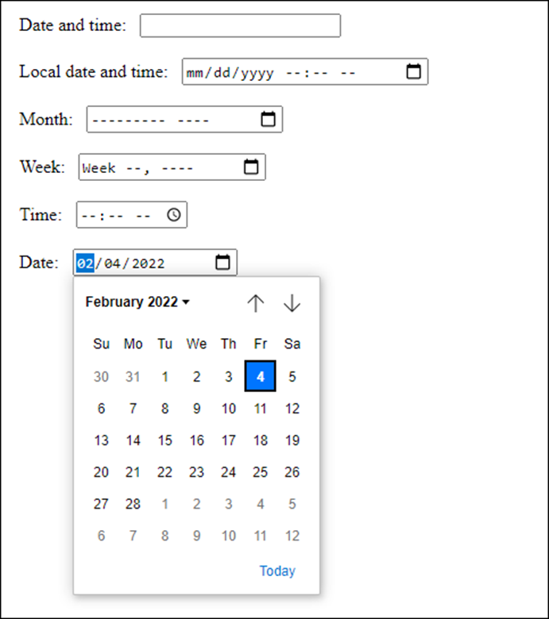
The controls in Chrome

Slide 22
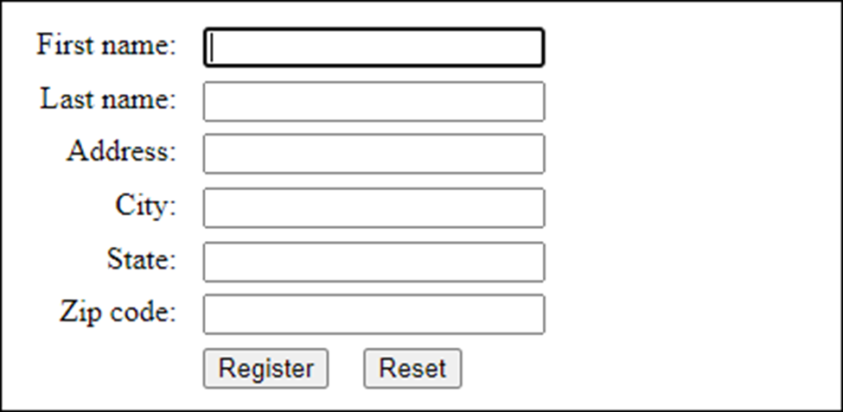
Label, text box, and button controls aligned on a form

Slide 23
The HTML for the form
<label for="firstname">First name:</label>
<input type="text" id="firstname" autofocus><br>
<label for="lastname">Last name:</label>
<input type="text" id="lastname"><br>
<label for="address">Address:</label>
<input type="text" id="address"><br>
<label for="city">City:</label>
<input type="text" id="city"><br>
<label for="state">State:</label>
<input type="text" id="state"><br>
<label for="zip">Zip code:</label>
<input type="text" id="zip"><br>
<input type="submit" id="button" value="Register">
<input type="reset" name="reset" id="reset">

Slide 24
The CSS for the controls
label {
float: left;
width: 5em;
text-align: right;}
input {
margin-left: 1em;
margin-bottom: .5em;}
#button {
margin-left: 7em;}

Slide 25
HTML that uses fieldset and legend elements
<form id="order" action="order.php" method="post">
<fieldset>
<legend>Crust</legend>
<input type="radio" name="crust" id="crust1"
value="thin">
<label for="crust1">Thin Crust</label><br>
<input type="radio" name="crust" id="crust2"
value="deep">
<label for="crust2">Deep Dish</label><br>
...
</fieldset>
<br>
<fieldset>
<legend>Toppings</legend>
<input type="checkbox" name="topping1" id="topping1"
value="pepperoni">
<label for="topping1">Pepperoni</label><br>
...
</fieldset>
</form>

Slide 26
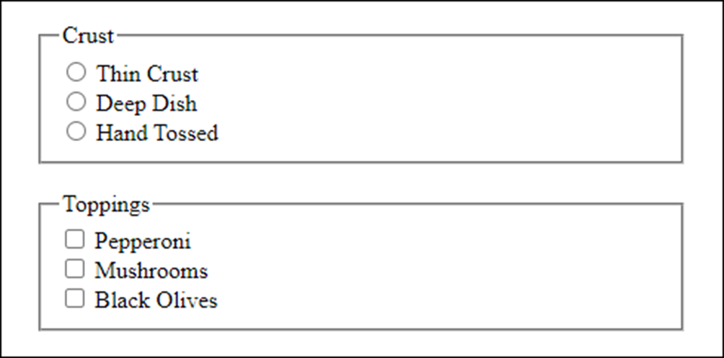
The elements in a web browser

Slide 27
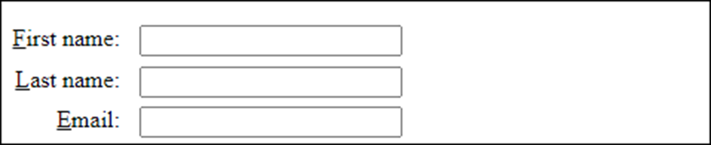
Three labels with access keys
The HTML for the controls
<label for="firstname"><u>F</u>irst name:</label>
<input type="text" id="firstname" accesskey="F"><br>
<label for="lastname"><u>L</u>ast name:</label>
<input type="text" id="lastname" accesskey="L"><br>
<label for="email"><u>E</u>mail:</label>
<input type="text" id="email" accesskey="E">

Slide 28
Another way to define the access keys
<label for="firstname" accesskey="F"><u>F</u>irst name:
</label>
<input type="text" id="firstname"><br>
<label for="lastname" accesskey="L"><u>L</u>ast name:
</label>
<input type="text" id="lastname"><br>
<label for="email" accesskey="E"><u>E</u>mail:</label>
<input type="text" id="email">

Slide 29
Accessibility guideline for tab order and access keys
Setting a proper tab order and providing access keys improves the accessibility for users who can’t use a mouse.

Slide 30
The HTML attributes for data validation
autocomplete
required
novalidate
formnovalidate

Slide 31
HTML that uses the validation attributes
Name: <input type="text" name="name" required><br>
Address: <input type="text" name="address"><br>
Zip: <input type="text" name="zip" required><br>
Phone: <input type="text" name="phone" required
autocomplete="off"><br>
<input type="submit" name="submit" value="Submit Survey">

Slide 32
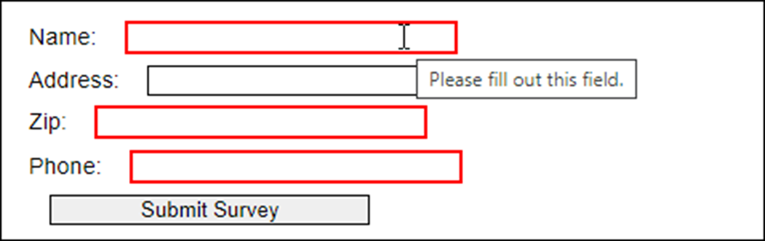
The error message and highlighting in Chrome

Slide 33
The CSS pseudo-classes for required, valid, and invalid fields
:required
:valid
:invalid

Slide 34
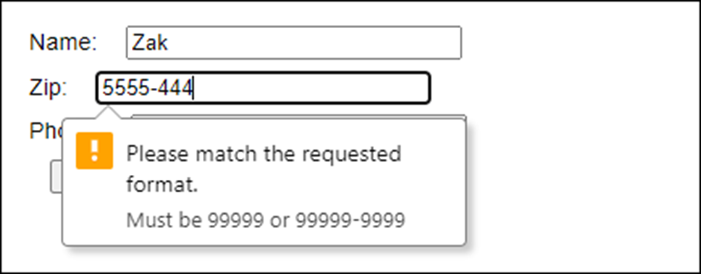
HTML that uses regular expressions
Name: <input type="text" id="name"
required autofocus><br>
Zip: <input type="text" id="zip" required
pattern="\d{5}([\-]\d{4})?"
title="Must be 99999 or 99999-9999"><br>
Phone: <input type="text" id="phone" required
pattern="\d{3}[\-]\d{3}[\-]\d{4}"
title="Must be 999-999-9999"><br>
<input type="submit" id="submit" value="Submit Survey">
The form in Chrome

Slide 35
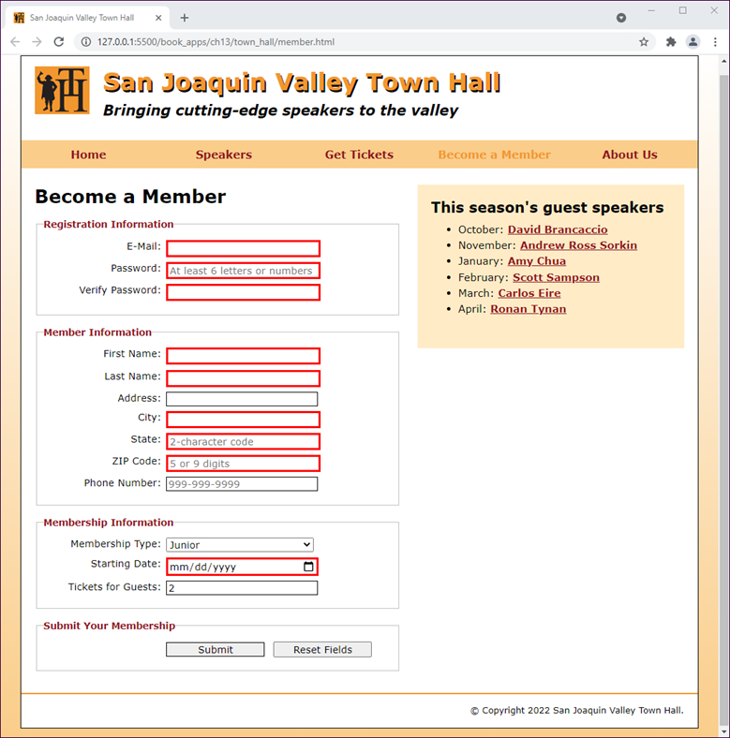
A form in Chrome that uses HTML validation

Slide 36
The HTML for the form (part 1)
<form action="register_account.html" method="get"
id="registration_form">
<fieldset>
<legend>Registration Information</legend>
<label for="email">E-Mail:</label>
<input type="email" name="email" id="email"
autofocus required><br>
<label for="password">Password:</label>
<input type="password" name="password" id="password" required
placeholder="At least 6 letters or numbers"
pattern="[a-zA-Z0-9]{6,}"
title="Must be at least 6 alphanumeric characters">
<br>
<label for="verify">Verify Password:</label>
<input type="password" name="verify"
id="verify" required><br>
</fieldset>

Slide 37
The HTML for the form (part 2)
<fieldset>
<legend>Member Information</legend>
<label for="first_name">First Name:</label>
<input type="text" name="first_name" id="first_name"
required><br>
...
...
...
<label for="state">State:</label>
<input type="text" name="state" id="state" required
maxlength="2"
placeholder="2-character code"><br>
<label for="zip">ZIP Code:</label>
<input type="text" name="zip" id="zip" required
placeholder="5 or 9 digits"
pattern="^\d{5}(-\d{4})?$"
title="Either 5 or 9 digits"><br>
<label for="phone">Phone Number:</label>
<input type="tel" name="phone" id="phone"
placeholder="999-999-9999"
pattern="\d{3}[\-]\d{3}[\-]\d{4}"
title="Must be 999-999-999 format"><br>
</fieldset>

Slide 38
The HTML for the form (part 3)
<fieldset>
<legend>Membership Information</legend>
<label for="membership_type">Membership Type:</label>
<select name="membership_type" id="membership_type">
<option value="j">Junior</option>
<option value="r">Regular</option>
<option value="c">Charter</option>
</select><br>
<label for="starting_date">Starting Date:</label>
<input type="date" name="starting_date" id="starting_date"
required><br>
<label for="tickets">Tickets for Guests:</label>
<input type="number" name="tickets" id="tickets"
value="2" min="1" max="4"
placeholder="from 1 to 4"><br>
</fieldset>
<fieldset id="buttons">
<legend>Submit Your Membership</legend>
<label>&nbsp;</label>
<input type="submit" id="submit" value="Submit">
<input type="reset" id="reset" value="Reset Fields"><br>
</fieldset>
</form>

Slide 39
The CSS for the form
fieldset {
margin-top: 1em;
margin-bottom: 1em;
padding-top: .5em;
}
legend {
color: #931420;
font-weight: bold;
font-size: 85%;
margin-bottom: .5em;
}
label, input, select {
font-size: 90%;
}
label {
float: left;
width: 12em;
text-align: right;
}

Slide 40
The CSS for the form (continued)
input, select {
width: 15em;
margin-left: .5em;
margin-bottom: .5em;
}
input:required {
border: 3px solid red;
}
input:valid {
border: 1px solid black;
}
input:invalid {
box-shadow: none;
}
br {
clear: both;
}
#buttons input {
width: 10em;
}

Slide 41
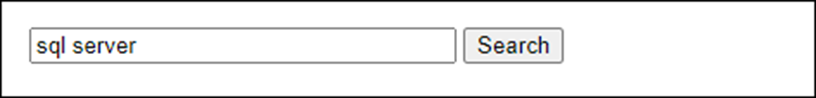
A search control in the Chrome browser

Slide 42
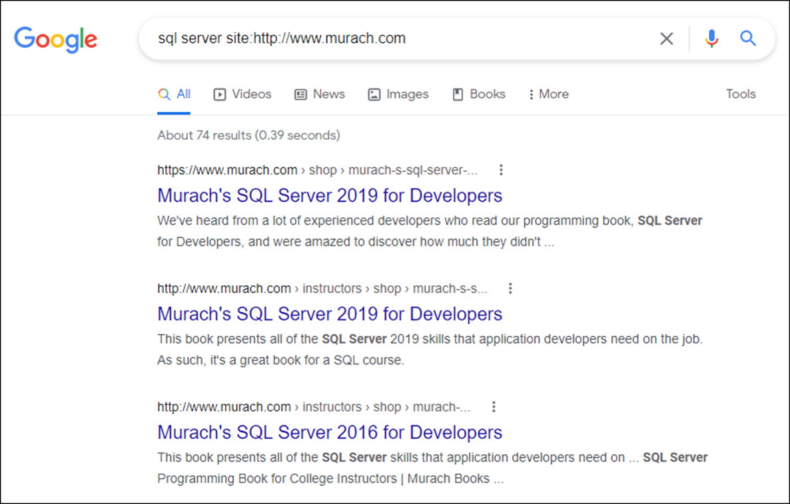
The results of the search when Google is used

Slide 43
The HTML for using the Google search engine
<form method="get" action="http://www.google.com/search">
<input type="search" name="q" size="30"
maxlength="255">
<input type="hidden" name="domains"
value="http://www.murach.com">
<input type="hidden" name="sitesearch"
value="http://www.murach.com">
<input type="submit" id="search" value="Search">
</form>

Slide 44
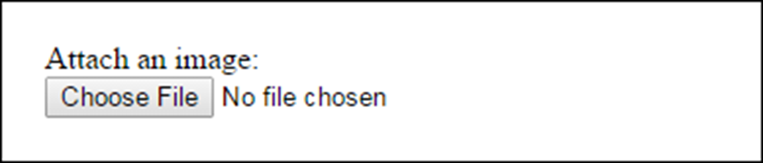
The HTML for a file upload control that accepts JPEG and GIF images
<form id="upload_form" action="sendemail.php"
method="post"
enctype="multipart/form-data">
Attach an image:<br>
<input type="file" id="fileupload"
accept="image/jpeg, image/gif">
</form>
The file upload control in the Chrome browser

Slide 45
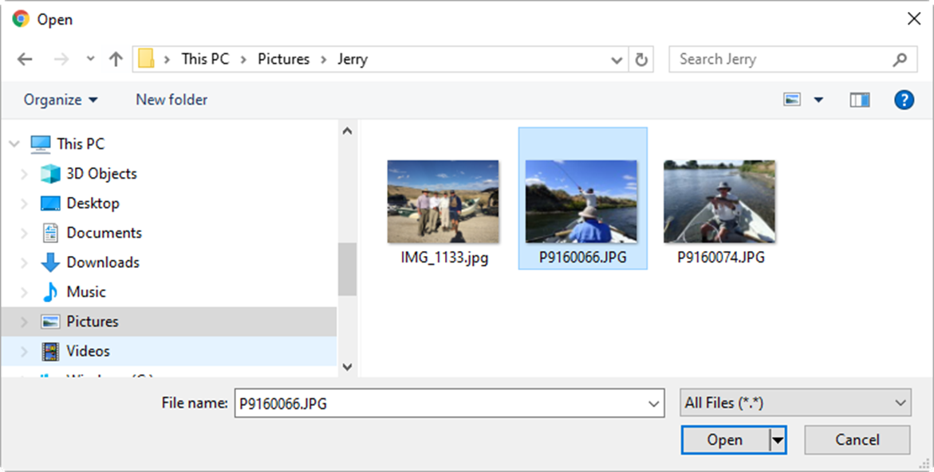
The Windows dialog box when Choose File is clicked

Slide 46
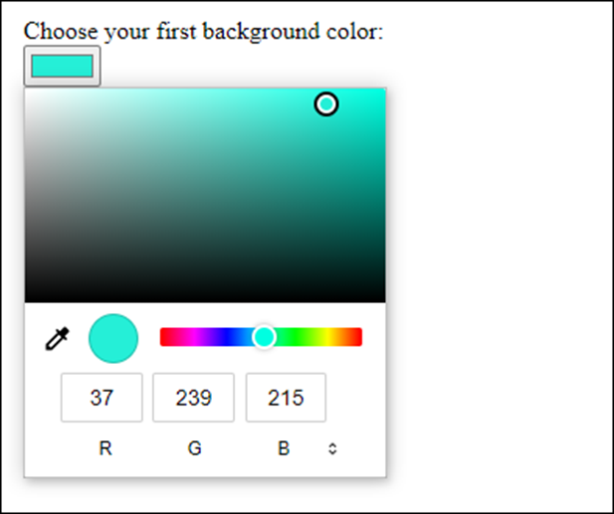
The HTML for a color control
<label for="firstcolor">
Choose your first background color:
</label>
<input type="color" id="firstcolor" value="#facd8a">
The color control in Chrome

Slide 47
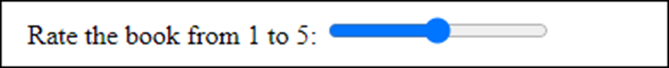
The HTML for a range control
<label for="book">Rate the book from 1 to 5: </label>
<input type="range" id="book"
min="1" max="5" step="1"><br><br>
The range control in Chrome

Slide 48
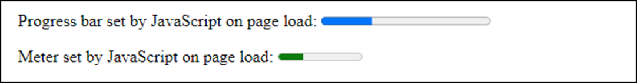
The HTML for progress and meter controls
<body onload="setProgressAndMeter()">
<p>Progress bar set by JavaScript on page load:
<progress id="progressBar" max="100"
value="0"></progress></p>
<p>Meter set by JavaScript on page load:
<meter id="meterBar" max="100"
value="0"></meter></p>
</body>
The progress and meter controls in Chrome

Slide 49
The HTML for a datalist control
<label for="link">What is your preferred search engine:
</label>
<input type="url" name="link" id="link" list="links">
<br><br>
<datalist id="links">
<option value="http://www.google.com/"
label="Google"></option>
<option value="http://www.yahoo.com/"
label="Yahoo"></option>
</datalist>

Slide 50
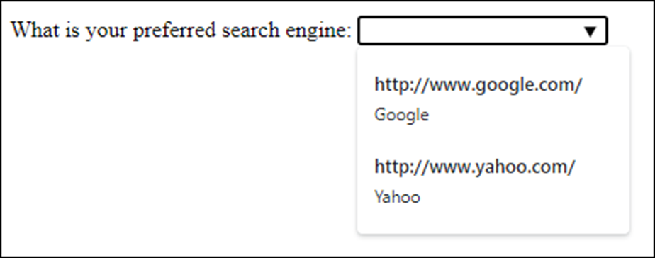
The datalist in Chrome

Slide 51
The HTML for an output control
<p>Enter numbers in both fields and click the Calculate
button.</p>
<form onsubmit="return false">
<input name="x" type="number" min="100" step="5"
value="100"> +
<input name="y" type="number" min="100" step="5"
value="100"><br><br>
<input type="button" value="Calculate"
onclick="result.value = parseInt(x.value) +
parseInt(y.value)">
<br><br>
Total: <output name="result" for="x y"></output>
</form>

Slide 52
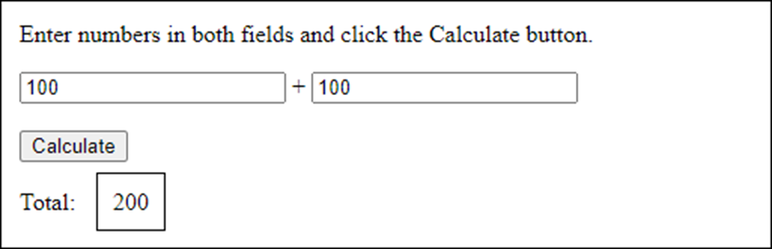
The form in Chrome with a border around the output element

Slide 53
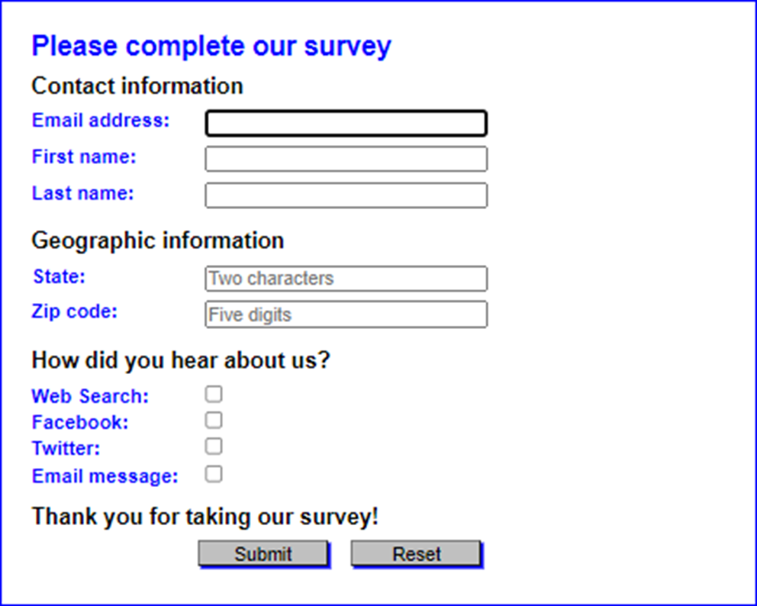
Short 13-1 Create a form

